Slide 1
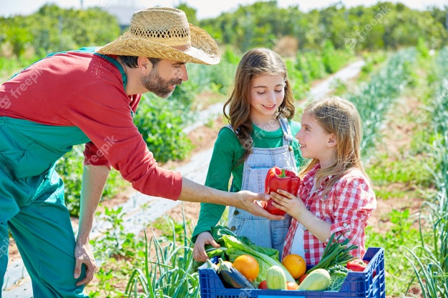
WEBSITE FOR BUYING AND SELLING FARM PRODUCE

Slide 2
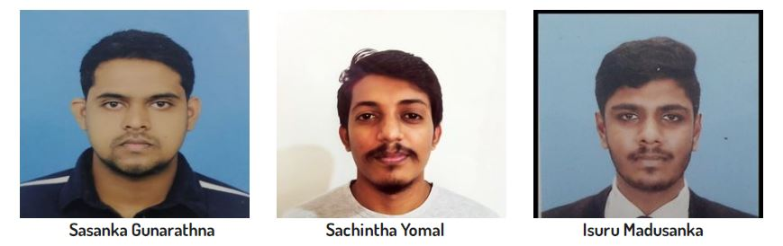
Team Members

Slide 3

Introduction of the Organization
Genoxia Technologies was established in the year 2021 and is currently providing our services in various fields.
In our latest project, "Healthy Farm Crops", we are providing services to increase the sales of agricultural products in our country and reduce the production wastage of our farmers. It is also committed as an organization to provide technical as well as advisory services through various channels to boost the economy of the country
Healthy Farm Crops

Slide 4
Sri Lanka Agriculture
The primary form of agriculture in Sri Lanka is rice production Vegetables, fruits and oilseed crops are also cultivated in the country.
Sri Lanka produces more than 800,000 metric tons of fruits and vegetables annually and exports both fresh and processed varieties to many destinations in the world.
The agricultural sector in the Sri Lanka 's economy with more than 70% of the population living in rural areas depending on agriculture for their livelihoods. Currently this sector contributes to about 18% of the GDP and 30% of the employment.

Slide 5
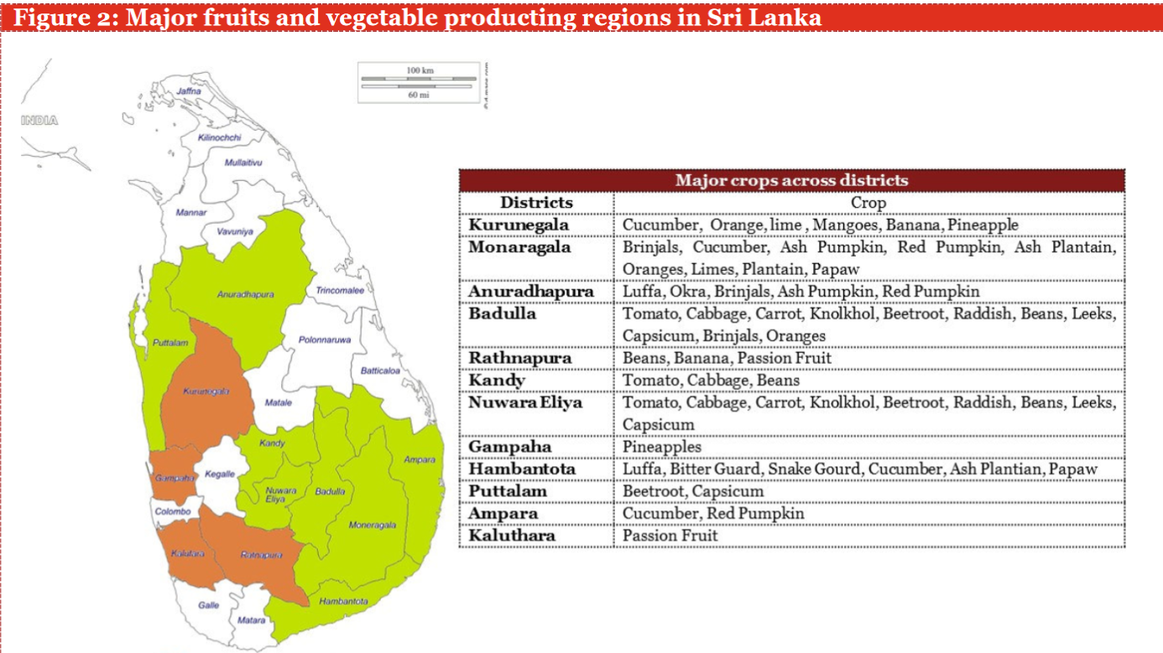
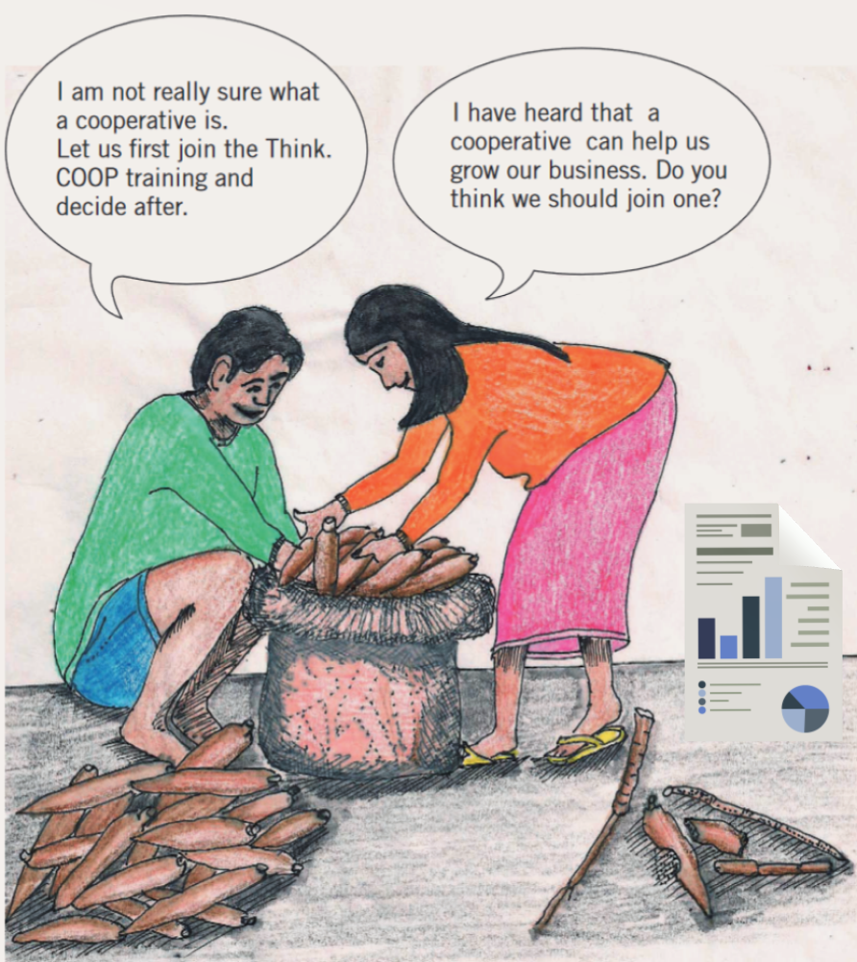

Slide 6
SOME SPECIAL THINGS TO BE CONSIDERED
A lots of farmers in our country are facing many type of huge problems like ,
They are unable to find marketplaces immediately.
when they are finding some sufficient buyers.
Weak delivery of services in rural areas.
Climate changes and natural disasters.
Heavy public sector regulatory interventions in commodity and input/factor markets.......etc..

Slide 7
As a result of above problems, a lots of agri/farm products have been wasting for a long period of time.
(FOOD WASTAGE)

Slide 8


Slide 9

Problem solution !!

Slide 10
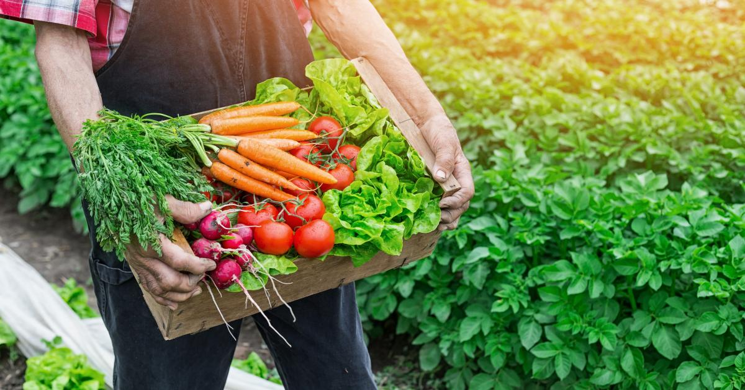
Selling farming products in economical centers can be very difficult. So, we are developing an all-in-one website for this task. which makes this website more user friendly and save more time and resources for farmer and buyers.
we can support farmers by featuring them on our website. So, buyers can find them at the tip of the search through our website.

Slide 11
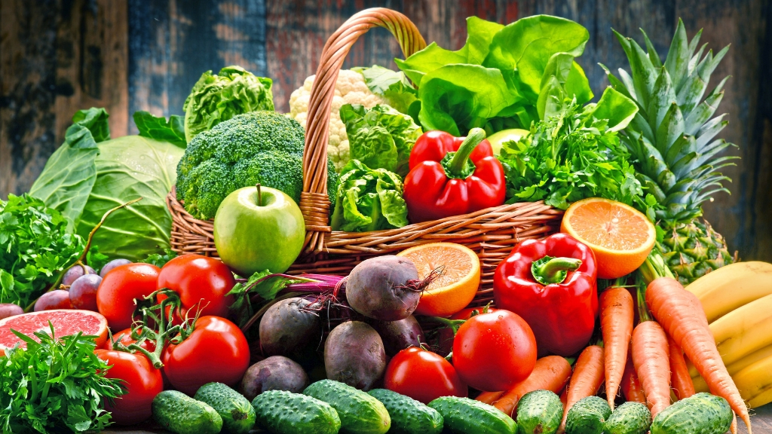
What is the purpose of this website ?
Finding the right customers for the business.
To prevent wastage of crop damage by trades.
Easy for customers to meet their customer needs at any time.
Ability to find buyers 24 hours a day.

Slide 12
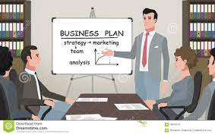
Implementation Plan
We have planned to increase the sales of these agricultural products and gradually reduce the wastage of agricultural produce.
This can be achieved by increasing the market opportunities for farmers and by making it easier for buyers to find farmers' produce very quickly and in quantities.
Buyers and sellers can be connected without interfering many brokers to get maximum revenue for the sellers.
There are stakeholders in our project.
Buyers
Sellers
Admin

Slide 13
In our ongoing project, buyers can place their wholesale and retail orders directly with registered agricultural producers of our healthy farm crops official website. Furthermore, the administrator of our website can manage all the buyers' and sellers’ details, available products, and the orders placed.
The first step in designing our website involves buyers and sellers. When the order is confirmed, sellers can get that order with buyers’ details from our website, and sellers can directly deliver related orders.

Slide 14
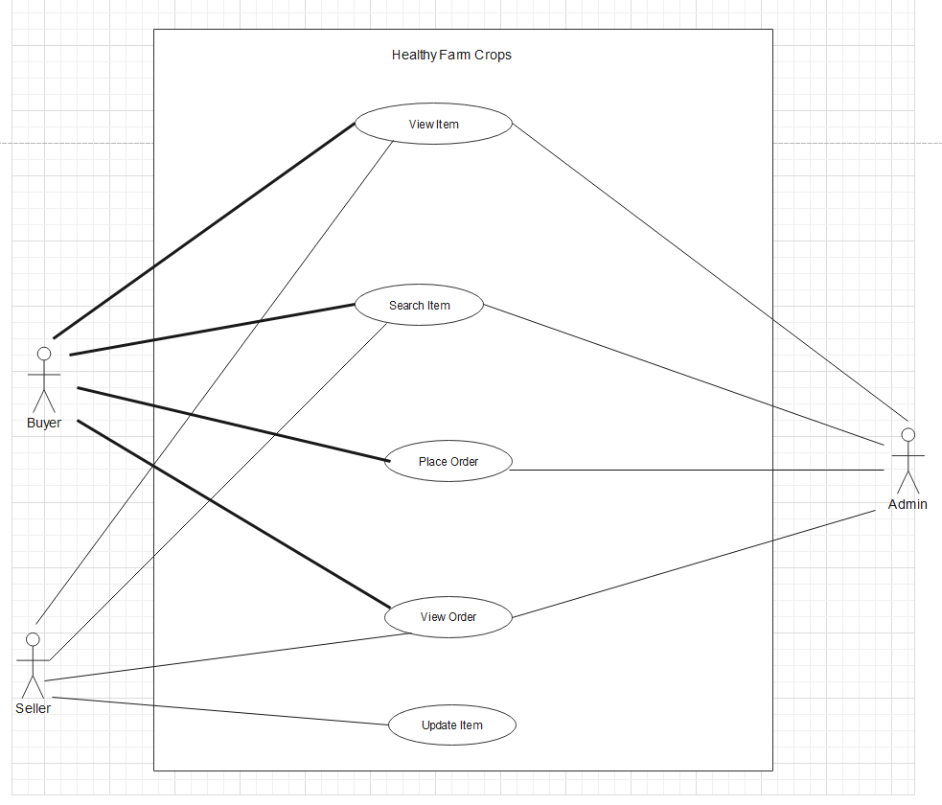
Use Case Diagram of current System

Slide 15
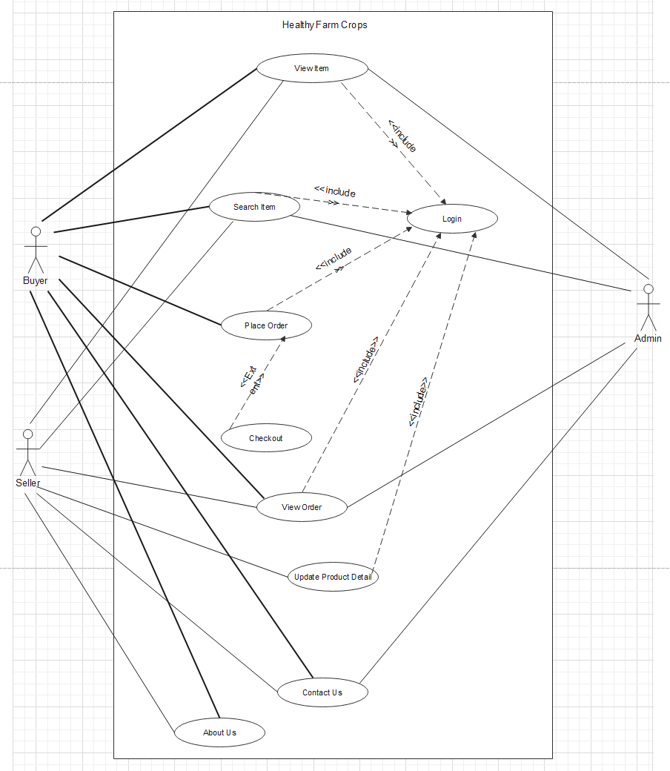
Use Case Diagram of proposed System

Slide 16
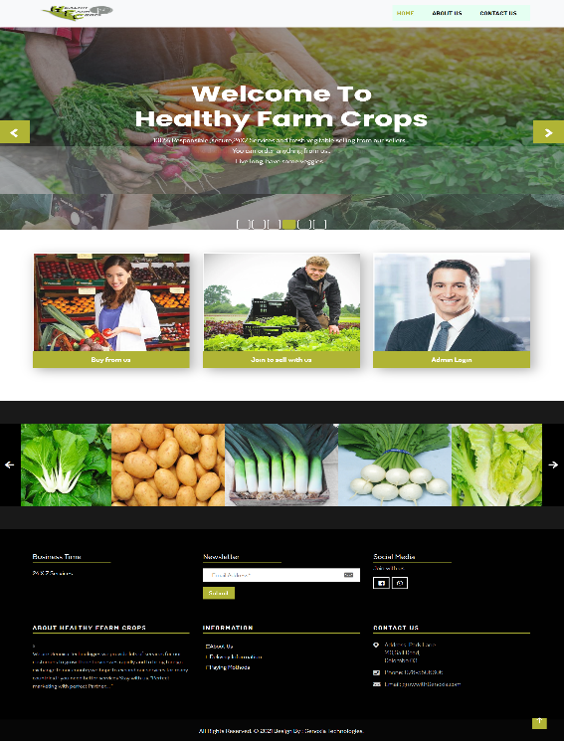
Home page

Slide 17
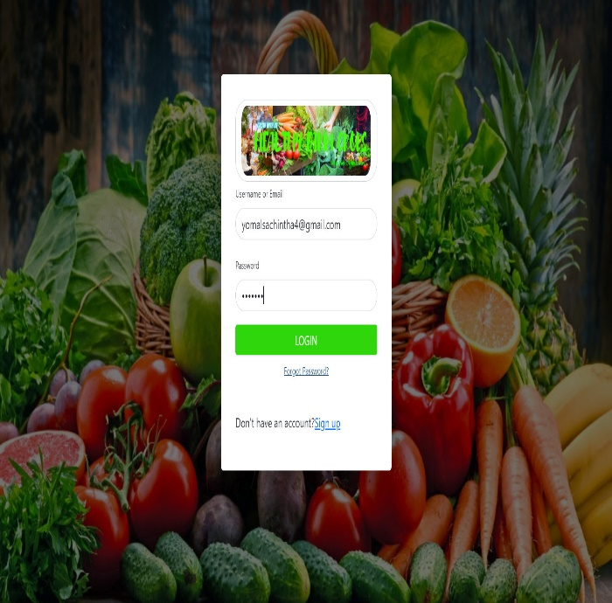
Login Page

Slide 18
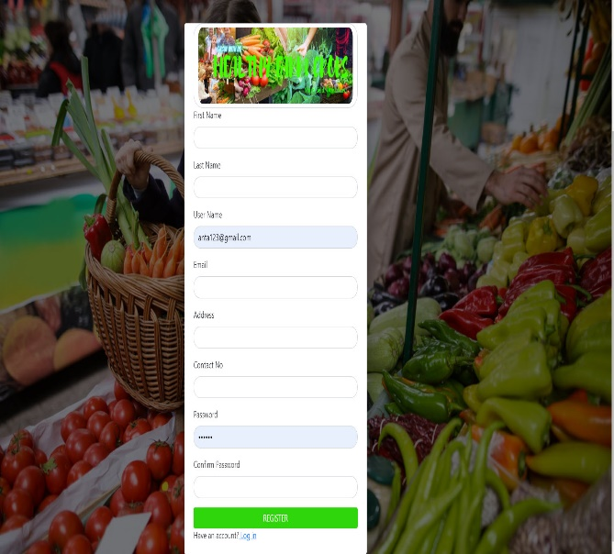
Register Page

Slide 19
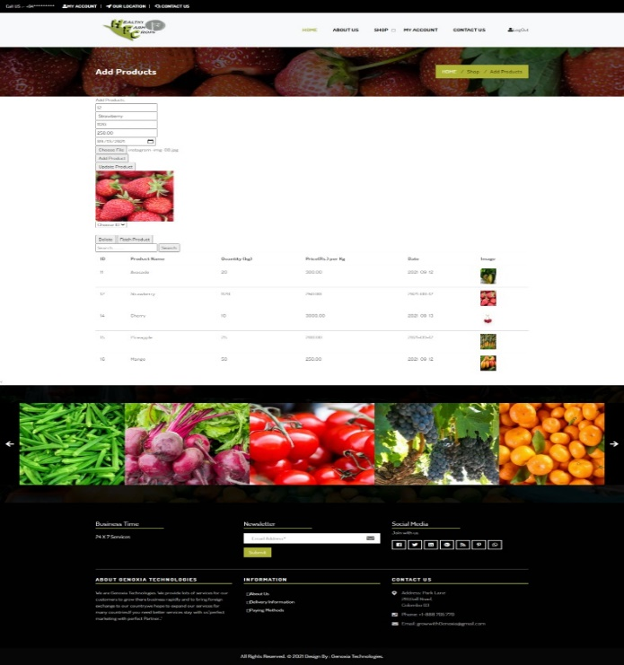
Add Product Page

Slide 20
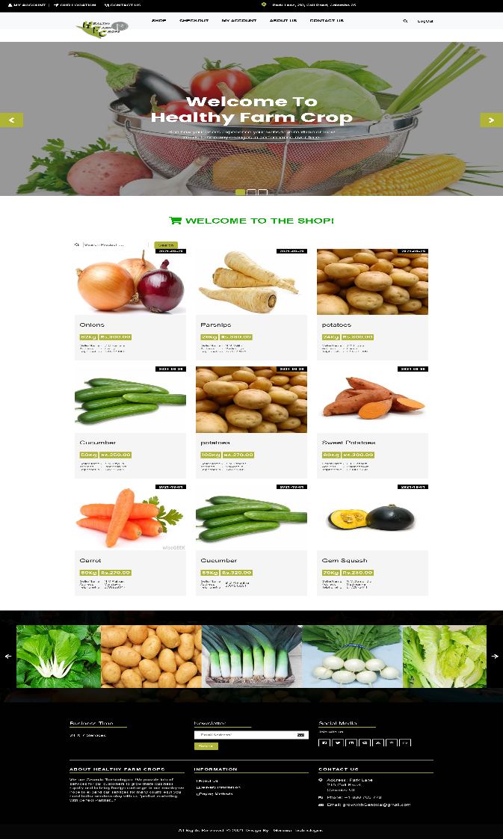
Shop page

Slide 21
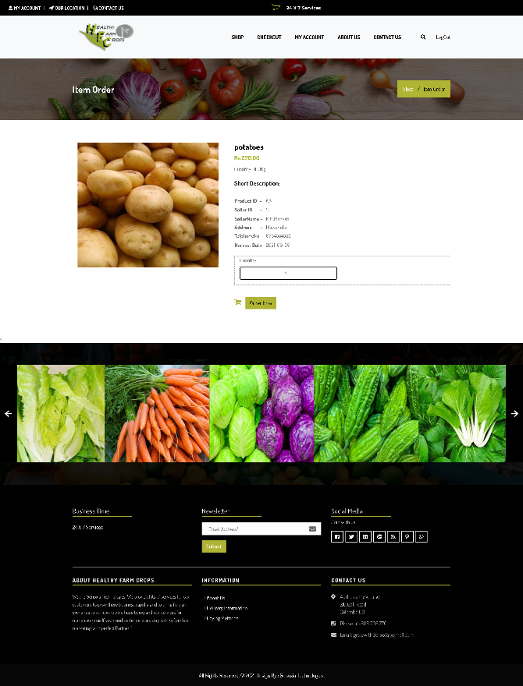
Item Order Page

Slide 22
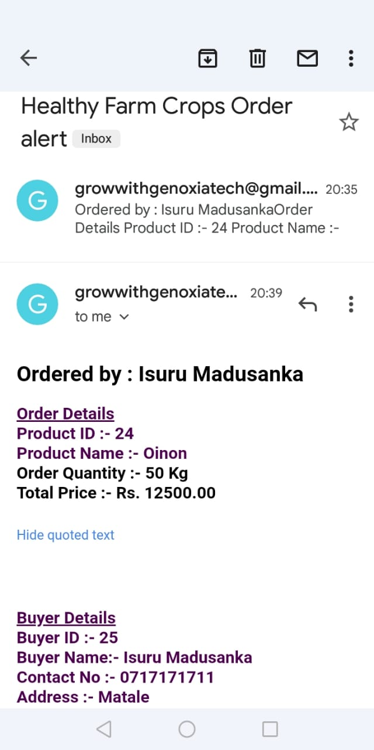
Auto Generate Order Email

Slide 23
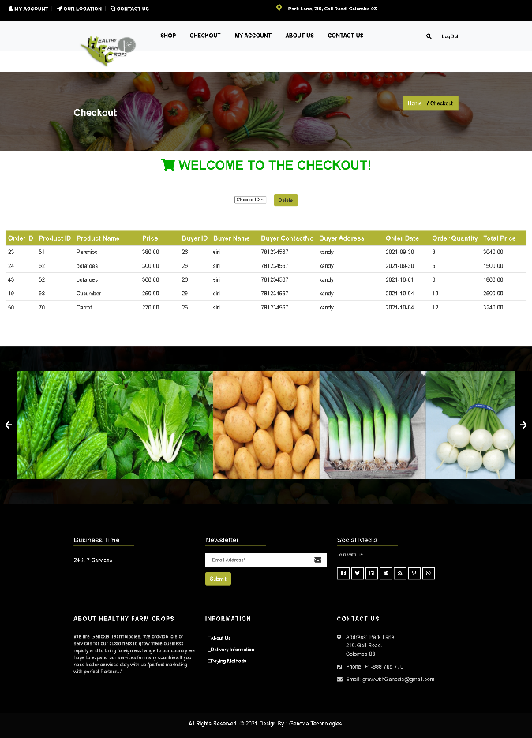
Checkout Page

Slide 24
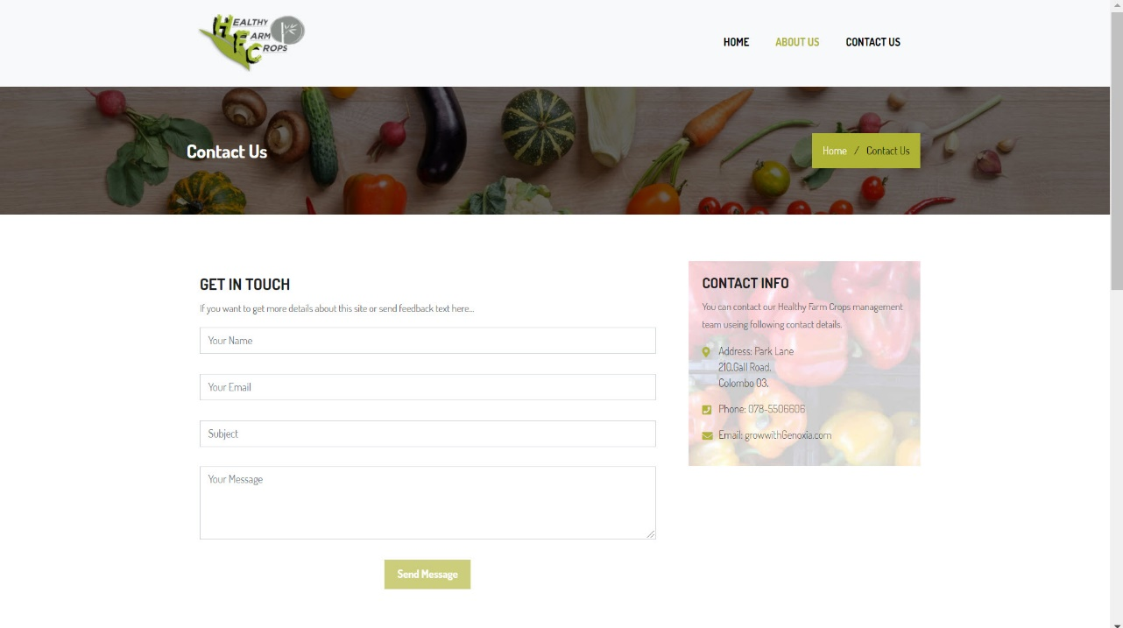
Contact Us Page

Slide 25
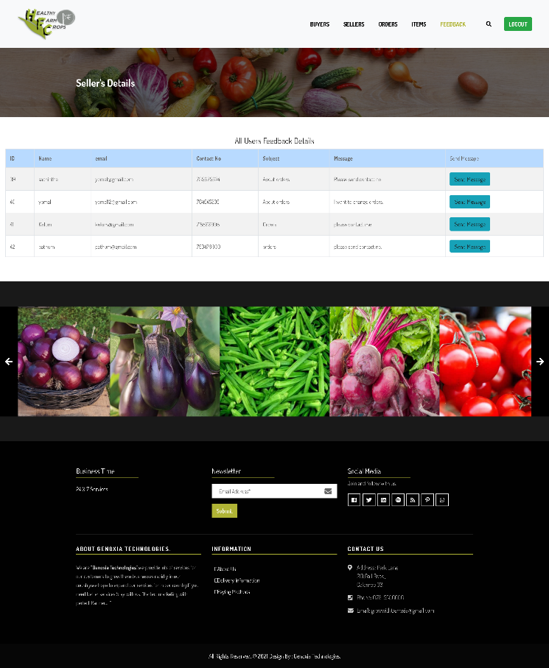
Admin Page – Feedback

Slide 26

Conclusion
Our Genoxia group created this website
in order to help farmers by showcasing them
on our site. As a result, customers may locate them at
the top of the search results on our website. Hopefully, we can work together to make this project a success by providing an easy-to-use platform for farmers and customers to sell and acquire agricultural products.

Slide 27
Healthy Farm Crops

Slide 28

Any Questions?

Slide 29

Thank You!

